Slide 1
HTML Entities
By Logan Pierce

Slide 2
HTML Entities
Reserved characters in HTML must be replaced with character entities.
Characters not present on your keyboard can also be replaced by entities.

Slide 3
Entity Names or Numbers
If you use the less than (<) or greater than (>) signs in your text, the browser might confuse them for tags.
Each HTML Entity can be represented with either a specific name or number.
(&entity_name; OR &#entity_number; )
Note: Entities are case sensitive.

Slide 4
Breaking Up is Hard to Do
A common character entity used in HTML is the non-breaking space: &nbsp;
A non-breaking space is a space that will not break into a new line.
Two words separated by a non-breaking space will stick together (not break into a new line). This is handy when breaking the words might be disruptive.
For example: “10 PM” or “60 MPH.”
If you hit the space button multiple times in your HTML text, the browser will only display one space. &nbsp; can be used to add multiple consecutive spaces which will show up in your browser.
The non-breaking hyphen ( &#8209; ) lets you use a hyphen character (‑) that won't break.

Slide 5
Entity Examples
 | non-breaking space | &nbsp; | &#160;
< | less than | &lt; | &#60;
> | greater than | &gt; | &#62;
& | ampersand | &amp; | &#38;
" | double quotation mark | &quot; | &#34;
' | single quotation mark (apostrophe) | &apos; | &#39;
¢ | cent | &cent; | &#162;
² | Superscript 2 | &sup2; | &#178;
½ | Fraction ½ | &frac12; | &#189;
♥ | Heart | &hearts; | &#9829;
© | copyright | &copy; | &#169;
® | registered trademark | &reg; | &#174;

Slide 6
“Oh hai, Diacritical Mark.”
A diacritical mark is a "glyph" added to a letter.
Some diacritical marks, like grave ( ̀) and acute ( ́) are called accents.
̀ | a | a&#768; | à
́ | a | a&#769; | á
̂ | a | a&#770; | â
̃ | a | a&#771; | ã
̀ | O | O&#768; | Ò
́ | O | O&#769; | Ó
̂ | O | O&#770; | Ô
̃ | O | O&#771; | Õ

Slide 7
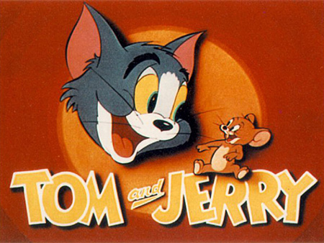
Entities HTML Code
Tom &amp; Jerry and all related characters and elements are trademarks &trade; and copyright &copy; of Turner Entertainment Co.
Tom & Jerry and all related characters and elements are trademarks ™ and copyright © of Turner Entertainment Co.

